Slide 1

CODE REFACTORING AND BUG FIXING
- A work by
Akshay Kumar

Slide 2


ABOUT ME
Hello, I am Bogaram Akshay Kumar, a graduate in Business Administration, Vikrama Simapuri University, Andhra Pradesh.
Why I learned Data Science? – Because in today’s digital age, data is like a new gold. Industries are heavily dependent on data to make critical business decisions.
Also ongoing buzz about AI and Open AI’s revolutionary chatbot made me passionate to learn data science. That’s where I have chose my career to become a data scientist.
Check Out my Profiles @

Slide 3
SCENARIO
A team of enthusiastic data scientists embarked on a mission to develop a Note Taking Application using Python, Flask, and HTML. However, their lack of experience in backend development has led to challenges in making the application fully functional. Recognizing your proficiency in backend development, you have been tasked with fixing the broken code and ensuring the application works seamlessly.
TASK
Refactor the existing codebase and ensure the proper functioning of the Note Taking Application. Document all identified bugs during the debugging process. Remember, the task is not about recreating the app from scratch. Your goal is to fix the already existing codebase and make the application work as intended.
LIBRARIES USED
FLASK : Flask framework used for creating web applications
RENDER_TEMPLATE : A function for rendering HTML templates
REQUEST: An object that represents the incoming HTTP request.

Slide 4
AGENDA
Understand the Current Codebase: Familiarize with the existing codebase. Understand the structure, libraries used, and the flow of data.
Identify the Bugs: Run the application and identify the bugs. Document each bug with a brief description and the conditions under which it occurs.
Prioritize the Bugs: Prioritize the bugs based on their impact on the application’s functionality. Critical bugs that prevent the application from running should be fixed first.
Fix the Bugs: Start fixing the bugs one by one, starting from the highest priority. Test the application thoroughly after each fix.
Refactor the Code: Look for opportunities to refactor the code. This could include removing redundant code, optimizing algorithms, or improving the readability of the code.
Test the Application: After all the bugs have been fixed and the code has been refactored, test the application thoroughly to ensure all features are working as expected.
Document the Changes: Document all the changes made, the bugs fixed, and any important observations during the process.
Review and Feedback: Have the code reviewed by peers for feedback. Make any necessary revisions based on the feedback receive

Slide 5
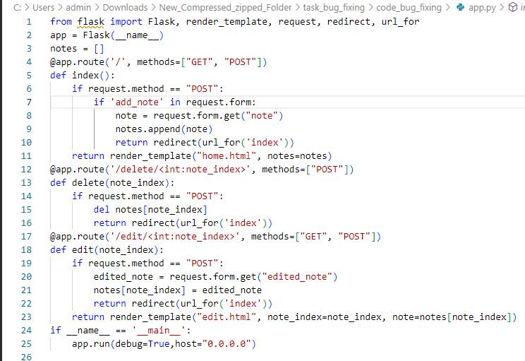
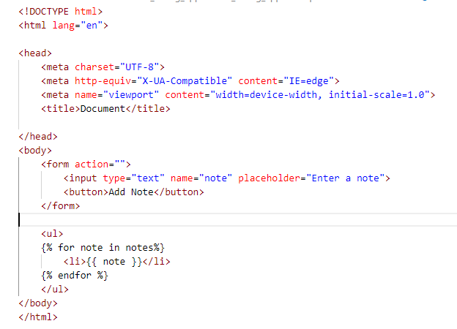
BEFORE BUG FIXING

Slide 6
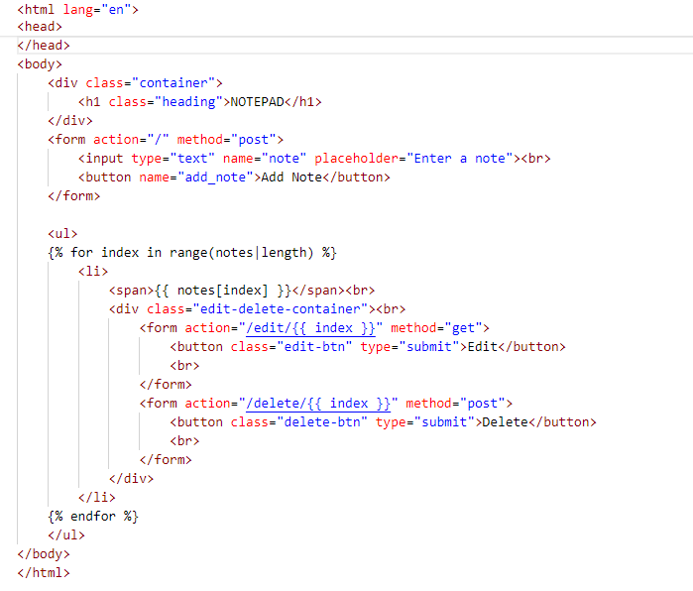
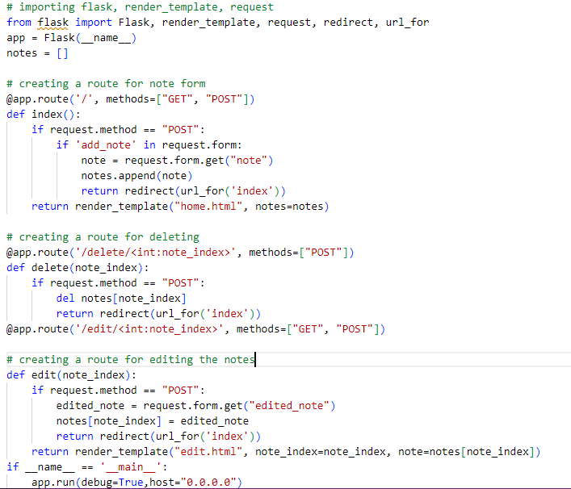
AFTER BUG FIXING

Slide 7
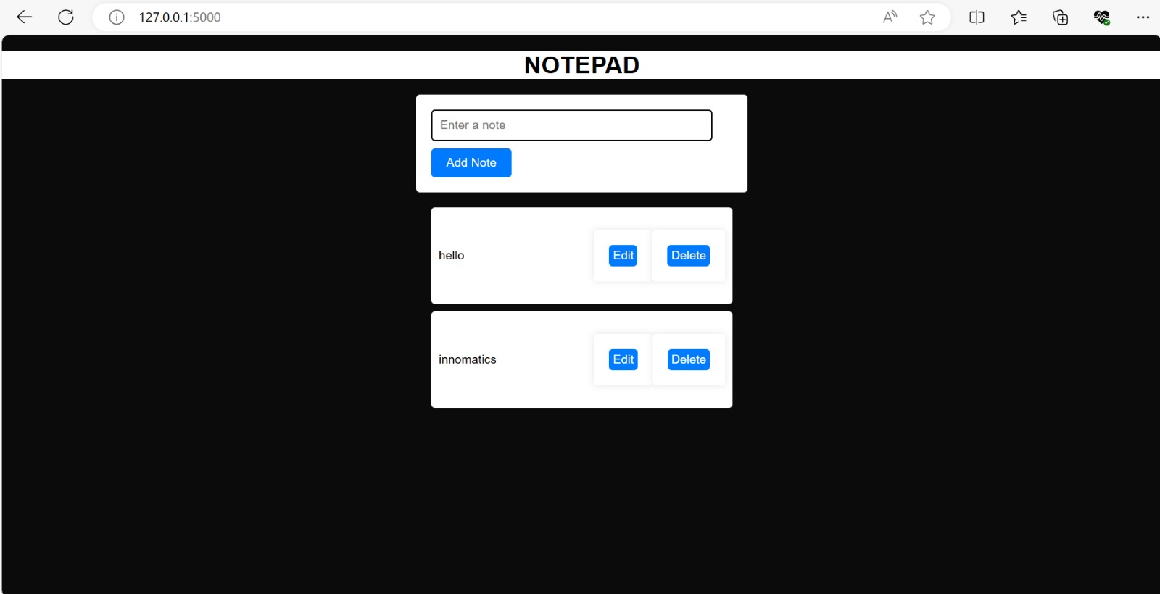
NOTEPAD WEBSITE

Slide 8

THANK YOU

